Slide 1
Department of Electronics & Communication Engineering Global Academy of Technology
NUMBER PLATE RECOGNITION
Under the guidance of: Presented By:
Mr. Tilak Kumar L. Uday Walvekar & Martin J.A
Assistant professor Ravi S.P & Venkata Reddy.S
Dept of ECE, GAT

Slide 2
CONTENTS
ABSTRACT
INTRODUCTION
LITERATURE SURVEY
BLOCK DIAGRAM AND FLOW CHART
DESIGN AND IMPLEMENTATION
RESULTS
CONCLUSION

Slide 3
ABSTRACT
Images of number plates in the database have been processed by various image processing techniques like acquisition, segmentation and recognition to obtain number plate.
Individual characters over the number plate are extracted through the process of segmentation and stored as individual images in separate database.
These characters are trained by artificial neural networks which gives high speed and greater accuracy.
The characters on number plate are verified from database and the plate is authenticated.

Slide 4
INTRODUCTION
Number plate recognition system is implemented as a computer vision i.e. extracting high level information from the image.
The system then enhances the image, detects the plate position, extracts the plate, segments the characters on the plate and recognizes the segmented characters.
The automatic tollgate system acts in real time with applications in law enforcement, parking, automatic toll gates, border crossing.

Slide 5
The project is combination of software for character recognition of images and development of hardware for character display.
Image processing section involves image pre-processing, image resize, cropping, colour image processing, intensity transformations, pixel connectivity.
Neural network consisting parallel inputs(neurons) are trained to match the target output.
The microcontroller is connected via max 232 for lcd display of number plate along with drivers to interface stepper motor for toll gate operation.

Slide 6
LITERATURE SURVEY
Due to different size and shape of number plates in various regions a distinctive research work has been done over this area.
Image detection techniques involve detection by standardizing location of plates on vehicles like edge detection techniques etc.
Character segmentation approaches involves direct segmentation approaches and projection and cluster analysis which are efficiently used in our project.
Character recognition approaches involve statistical pattern recognition which uses the probabilistic model.

Slide 7
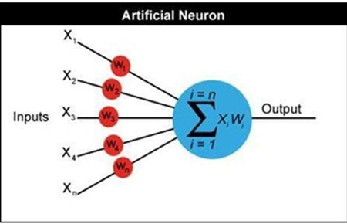
Also a unique approach of template matching is used where each possible input has a unique template to match the output. This theory has also served base for our project.
The major challenges faced are optimum lighting conditions i.e. a good flash of camera and also lack of background detail.

Slide 8
BLOCK DIAGRAM
NUMBER PLATE IMAGE AS THE INPUT
COMPUTER PROCESSING USING MATLAB OUTPUT KA 04 ME 6152
MUC
8051
ULN
2803
COMPARE WITH IMAGE DATABASE TO AUTHENTICATEU
TRAIN BY
STEPPER MOTOR ROTATES TO OPEN TOLLGATE
KA 04 ME 6152
LCD NUMBER PLATE DISPLAY
NEURAL NETWORK

Slide 9
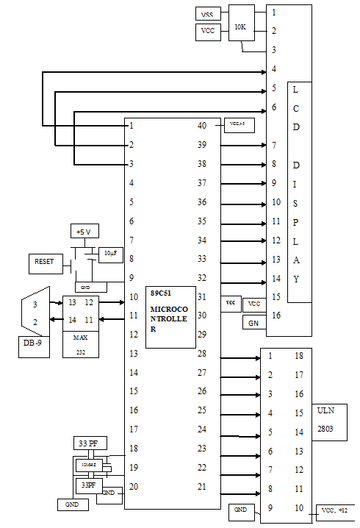
HARD WARE
BLOCK
DIAGRAM

Slide 10
A
Gray to binary conversion
IMAGE PROCESSING
FLOWCHART STEPS
Image filling
Inversing of Image
Getting ROI part
Inverse of Image
Start
Removing noise
Image capturing
Pre –processed image
Images Stored in database
Finding the width and height if each character
Images read from data base
Extracting region of objects
RGB to gray conversion
Resizing of extracted images
Image resize
Converting images to column vector then sending I/P Neural Network
Image cropping
A
B

Slide 11
B
HARDWARE
FLOWCHART STEPS
If image is identified?
No
Yes
Respective character identified and stored in variable result
It is consider blank
Start
Sending recognized characters serially to microcontroller
Enable the interrupt serial, into and int1 using IE register.IE=#95H
Microcontroller received characters from PC displaying In LCD
Initialize of TMOD register Timer 1, mode 2
Stepper motor rotating 90̊ clock wise and 90 ̊ anti clock wise
Set the timer 1
Stop
Selecting the data, stop bit using SCON register
Initialize the LCD
X

Slide 12
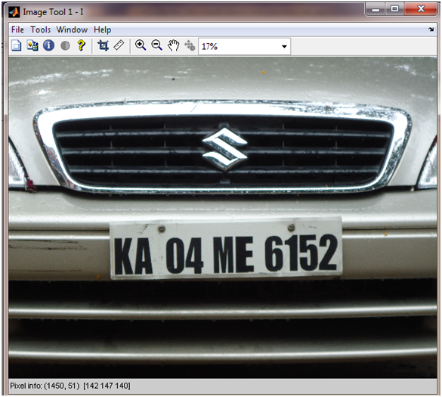
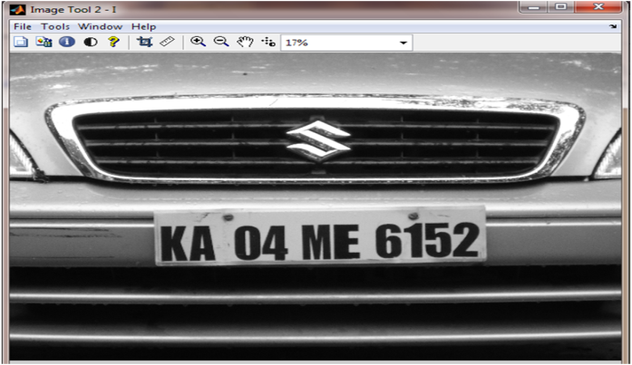
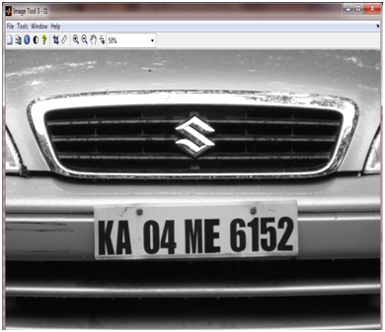
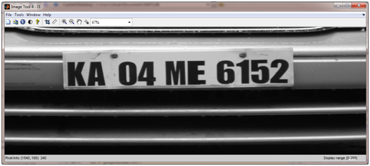
IMPLEMENTATION
1. Captured image
2. Rgb to gray
3. Image resize 1000R 2000C
4. Cropped Image 601R and 1701C

Slide 13
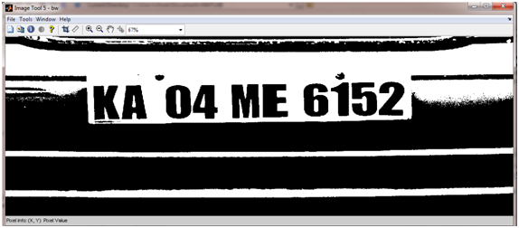
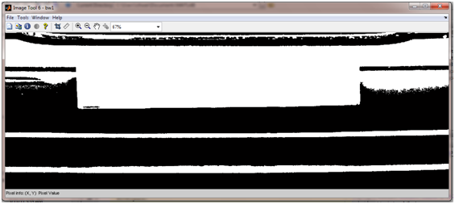
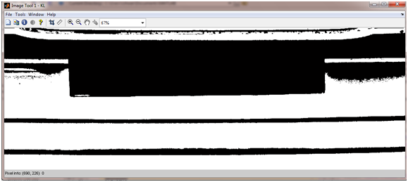
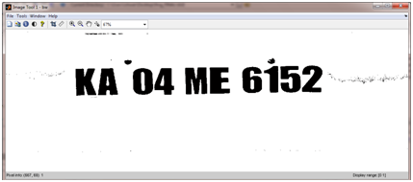
5.
6.
Image fill
Gray to binary image
8.
7.
Inverse image
Step 5 + 7

Slide 14
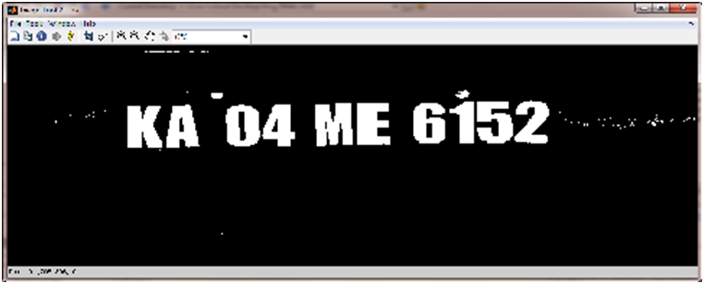
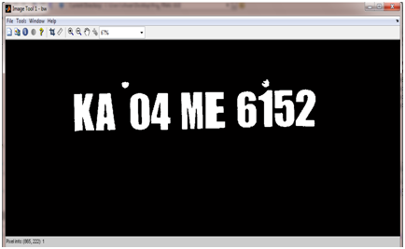
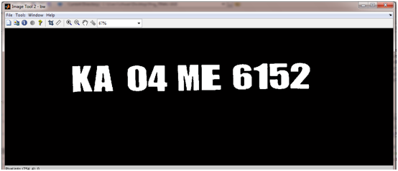
9.
10.
Inversed image
Removed small noise
11.
Pre-processed image

Slide 15
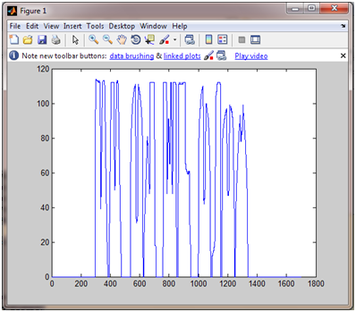
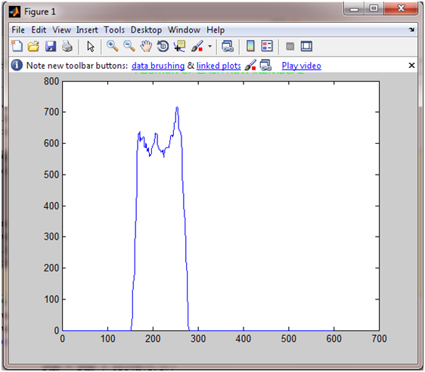
Sum individually 1.each column and 2. each row

Slide 16
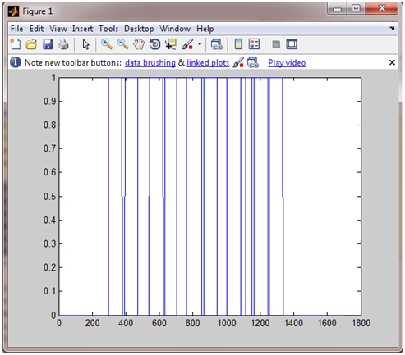
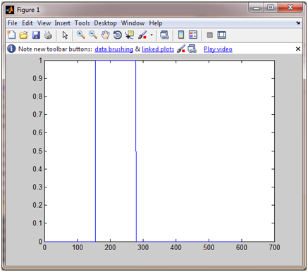
Plot using threshold values for row & column sum

Slide 17
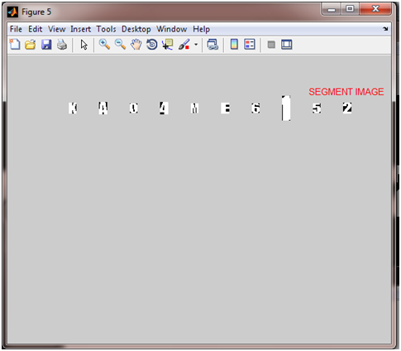
xloc
Columns 1 through 12
297 377 394 471 539 622 631 702 759 851 863 942
Columns 13 through 21
1000 1083 1114 1151 1162 1246 1254 1335 1701
Finding the
height of the
each character.
yloc1
166 280
165 279
165 277
165 277
162 275
161 273
160 270
156 268
155 268
154 266
height by
width less <18
Extracted objects

Slide 18










Resizing all the candidates 90 rows and 40 columns.

Slide 19
IMPLEMENTATION FOR NEURAL
NETWORK SECTION
Row is converted in to column giving input to neural network.
The same formula of height by width less then 18 is applied to get other inputs for the neural network.
The columns are converted to vector as neural network only accepts inputs in vector form.
Send each character serially at the baud rate of 9600.
Display result in notepad using function “winopen”.
There are around 168 type of inputs trained by neural networks.
Whenever a particular input is recognized the corresponding neuron goes high.

Slide 20
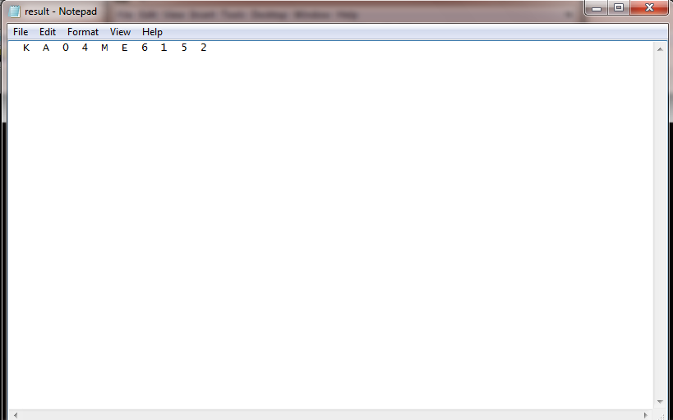
Recognized
Characters
Of number
plates

Slide 21
HARDWARE STEPS
Microcontroller receives all character from computer at the baud rate of 9600.
Receive all character display in LCD.
After receiving all the character stepper motor rotates 90 ̊ clock wise direction and then 90 ̊ anti clock wise direction.
Writing data in to the LCD “WEL COME TO NUMBER PLATE”
Clearing the LCD screen by sending the command #01H.
Waiting for characters receive from Personal Computer (PC).
After receiving the first character from PC, display first line of LCD “NUMBER PLATE”. Then in second line displaying all characters receive from PC (Recognized characters).
Clear the screen of LCD.

Slide 22
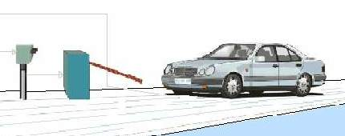
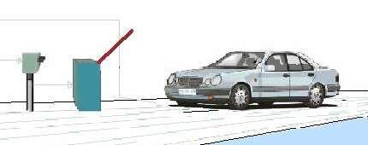
Stepper motor rotates clock wise direction 90̊ and displays in LCD “GATE OPENED”.
Stepper motor rotates anti clock wise direction 90̊ and displaying in LCD “GATE CLOSED”.
Clear the screen of LCD.

Slide 23
RESULTS
A total of 19 images with vehicle number plates taken under different lighting conditions, different distance, different exposure were used as input to the system.
The images were originally taken by 10.1 MP digital camera and resized to 1000x2000 for fast processing.
The operations of plate localization and character segmentation are done whose results are shown on next page.
The character recognition process gives a complete result due to good accuracy from training inputs by neural networks.

Slide 24
Plate Localization Success Rate
Total Images | Plate located | Failed to locate | Success Rate
19 | 18 | 1 | 94.73%
Character Segmentation Success Rate
Images Character | Character Segmented | Failed | Success rate
18 | 17 | 1 | 94.44%

Slide 25
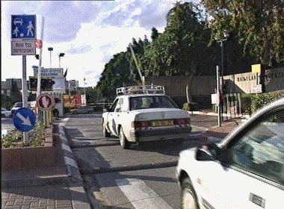
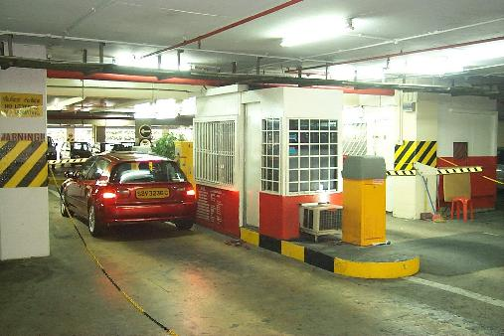
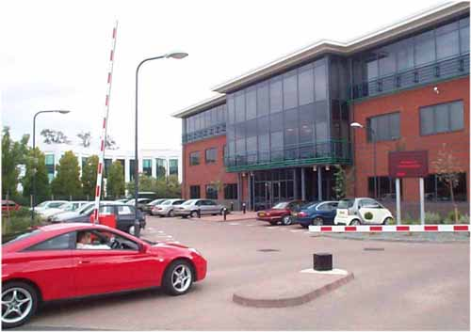
Typical Applications
Traffic control
Parking
Access control
the NPR based system classifies the cars on a congested entrance to 3 types (authorized, known visitors, and unknown cars for inquiry) and guides them to the appropriate lane. This system reduced the long waiting lines and simplified the security officers work load.
Car is entering a car park in a shopping center. The car plate is recognized and stored. When the car will later exit, the car plate will be read again. The driver will be charged for the duration of the parking. The gate will automatically open after payment
the gate has just been automatically raised for the authorized vehicle, after being recognized by the system. A large outdoor display greets the driver. The event (result, time and image) is logged in the database.

Slide 26
CONCLUSION
We proposed an improved NPR system for all types of NP, which included of three modules: license plate location, characters segmentation and characters recognition.
A network for characters & numbers is trained with noises in the training task .
We have tested our improved NPR system on 19 vehicle images taken from actual system with different conditions: lightening conditions (night & day), license angles, illumination, colors and reflected light.
Our NPR method is more effective . The efficiency of computing time & accuracy is improved and very satisfied for all types of LP and environment.

Slide 27
BIBLIOGRAPHY
Digital image processing by Rafael C.Gonzalez and Richard E.Wood.
Comelli, P., Ferragina, P., Granieri. M. N., and Stabile, F., "Optical recognition of motor vehicle license plates", IEEE Transactions on Vehicular Technology, vol. 44, no. 4, pp: 790-799,1995.
Nieuwoudt, C, and van Heerden, R., "Automatic number plate segmentation and recognition", Seventh annual South African workshop on Pattern Recognition, pp. 88-93, IAPR, 1996.

Slide 28


Slide 29
THANK YOU

